Slide 1
Chapter 6
High-Speed LANs

Slide 2
Introduction
Fast Ethernet and Gigabit Ethernet
Fibre Channel
High-speed Wireless LANs

Slide 3
Characteristics of High-Speed LANs
 | Fast Ethernet | Gigabit Ethernet | Fibre Channel | Wireless LAN
Data Rate | 100 Mbps | 1 Gbps, 10 Gbps | 100 Mbps – 3.2 Gbps | 1 Mbps – 54 Mbps
Transmission Mode | UTP,STP, Optical Fiber | UTP, shielded cable, optical fiber | Optical fiber, coaxial cable, STP | 2.4 GHz, 5 GHz Microwave
Access Method | CSMA/CD | CSMA/CD | Switched | CSMA/CA Polling
Supporting Standard | IEEE 802.3 | IEEE 802.3 | Fibre Channel Association | IEEE 802.11

Slide 4
Emergence of High-Speed LANs
2 Significant trends
  Computing power of PCs continues to grow rapidly
  Network computing
Examples of requirements
  Centralized server farms
  Power workgroups
  High-speed local backbone

Slide 5
Classical Ethernet
Bus topology LAN
10 Mbps
CSMA/CD medium access control protocol
2 problems:
  A transmission from any station can be received by all stations
  How to regulate transmission to handle “collisions”?

Slide 6
Solution to First Problem
Data transmitted in blocks called frames:
  User data
  Frame header containing unique address of destination station
Max. 1518 Octets

Slide 7
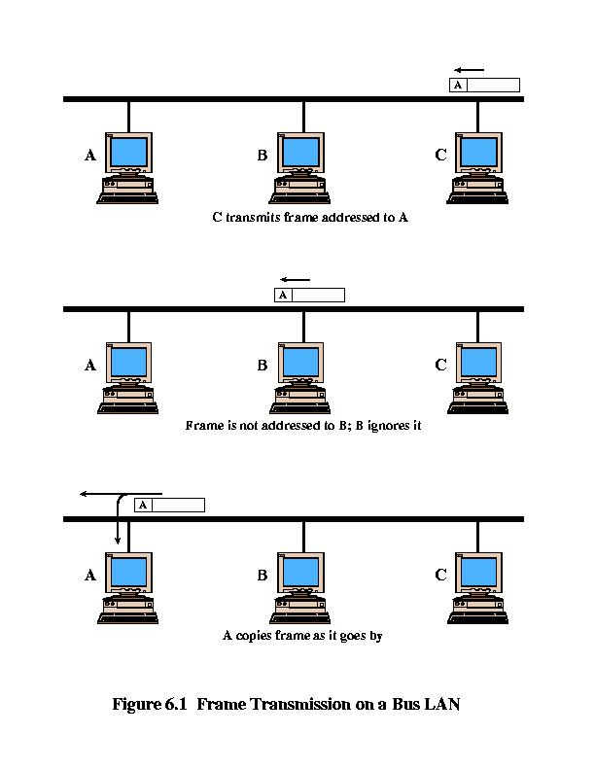
Frame Transmission on a Bus

Slide 8
Solution to the second problem: CSMA/CD
Carrier Sense Multiple Access/ Carrier Detection
If the medium is idle, transmit.
If the medium is busy, continue to listen until the channel is idle, then transmit immediately (actually, + 96 clock ticks).
If a collision is detected during transmission, immediately cease transmitting.
After a collision, wait a random amount of time, then attempt to transmit again (repeat from step 1).

Slide 9
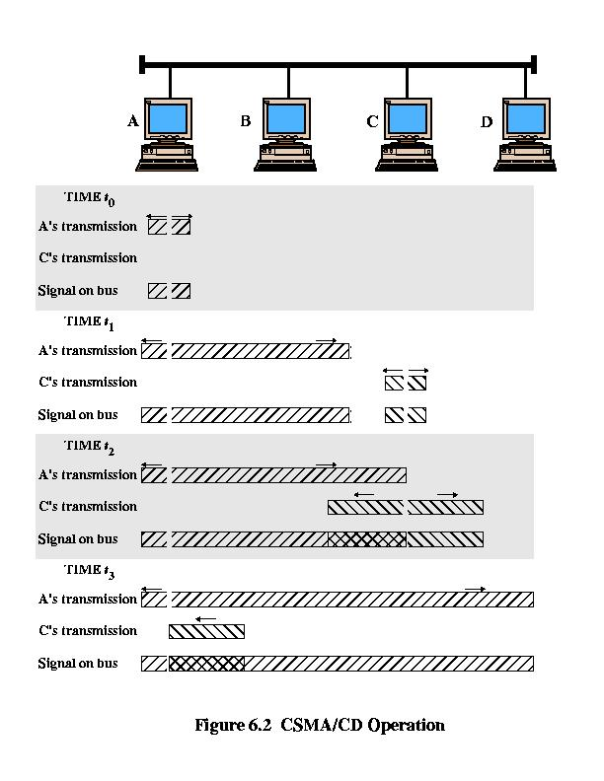
CSMA/CD Operation

Slide 10
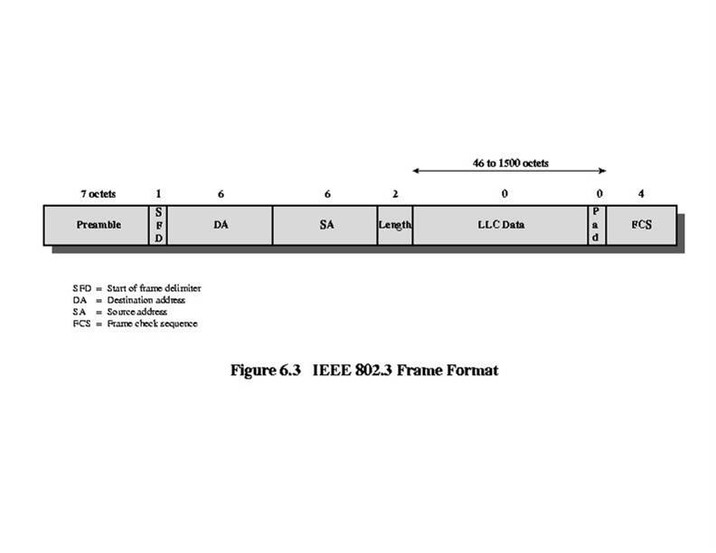
IEEE 802.3 Frame Format
Preamble
7 octets with pattern 10101010, followed by one byte with pattern 10101011 (SFD)
used to synchronize receiver, sender clock rates
Note: IEEE 802.3 specifies that frame length, excluding preamble and SFD, must be between 64 and 1518 bytes. Data is padded to 1500 bytes, if necessary, to ensure that the minimum length is achieved.

Slide 11
IEEE 802.3 Frame Format
Addresses: frame is received by all adapters on a LAN and dropped if address does not match
Length: indicates the length of data segment (min. 46 bytes, max. 1500 bytes). Note: in Ethernet this is higher layer protocol, mostly IP but others may be supported such as Novell IPX and AppleTalk)
LLC Data: data from next-higher layer protocol
Pad: used to fill out data to minimum of 46 bytes
FCS: CRC₃₂ checked at receiver, if error detected, the frame is usually dropped

Slide 12
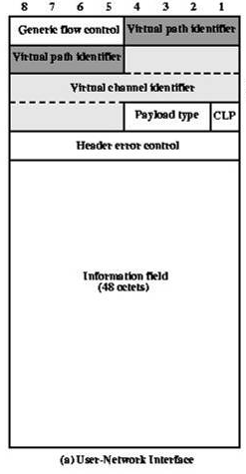
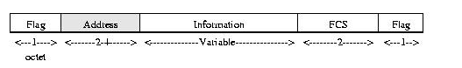
IP & IEEE 802.3 Framing
Frame Relay Frame Format
ATM Cell Format

Slide 13
Medium Options at 10Mbps
IEEE notation:
<data rate> <signaling method> <max length>
10Base5
  10 Mbps
  50-ohm coaxial cable bus
  Maximum segment length 500 meters
10Base-T
  Twisted pair, maximum segment length 100 meters
    10Base-F fiber standard extends to 2000 meters
  Star topology (hub or multipoint repeater at central point)

Slide 14
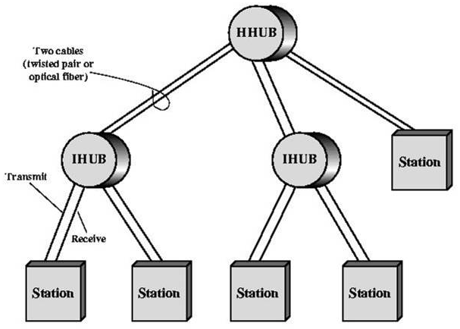
Star Topology: 2-level

Slide 15
Hubs and Switches
Hub
Physical amplification and retransmission of bits (repeater)
Transmission from a station received by central hub and retransmitted on all outgoing lines
Only one transmission at a time
Logically, a bus
Layer 2 Hub (Switch)
Incoming frame buffered and then switched to one outgoing line
Many transmissions at same time

Slide 16

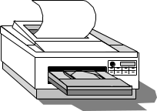

Hubs and Switches
●     
High-Speed Backplane or Interconnection fabric
●   

Slide 17
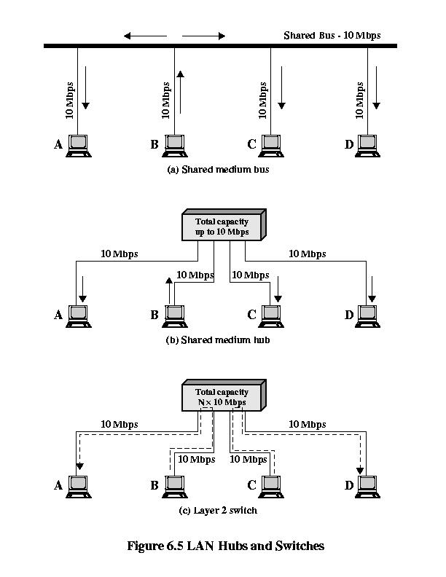
10Base-T Hubs and Switches

Slide 18
Bridges vs. Layer-2 Switches
Bridge
Frame handling done in software
Analyze and forward one frame at a time
Store-and-forward
Separate collision domains
Layer 2 Switch
Frame handling done in hardware
Multiple data paths and can handle multiple frames at a time
Store-and-forward, but can do cut-through
No collisions

Slide 19
Layer 2 Switches
Flat address space, leading to:
Common Broadcast address…… broadcast storms
Only one path between any 2 devices
Solution 1: subnetworks connected by routers
Solution 2: layer 3 switching, packet-forwarding logic in hardware
  packet-by-packet… like router
  flow-based… using IPv6

Slide 20
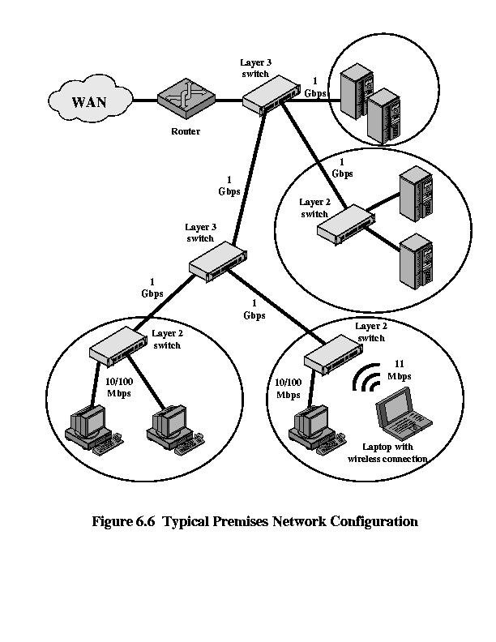
Typical Premise Network

Slide 21
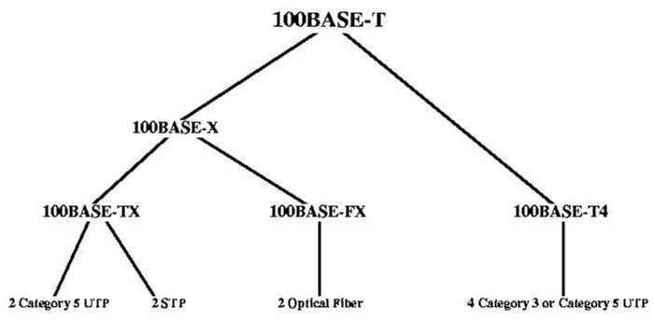
IEEE 802.3 100Base-T Option Taxonomy
IEEE 802.3u (100 Mbps)
High-quality
cabling
Lower-quality
cabling
Note: 100Base-T specification also allows full-duplex operation.

Slide 22
802.3 Ethernet CSMA/CD Efficiency
1
1 + 6.44( )
Efficiency =
t_{prop}
t_{trans}
the parameter ‘a’

Slide 23
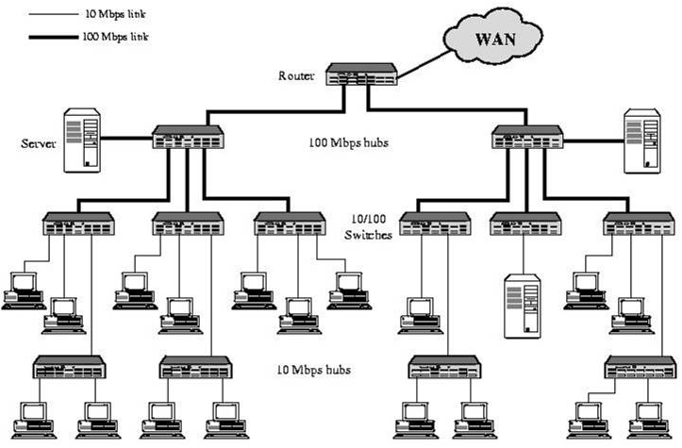
100Mbps Backbone Example
100Mbps
Backbone

Slide 24
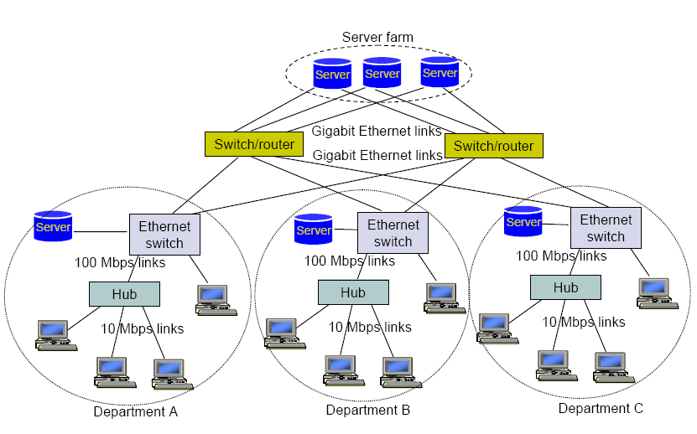
Gigabit Ethernet Example (IEEE 802.3z)

Slide 25
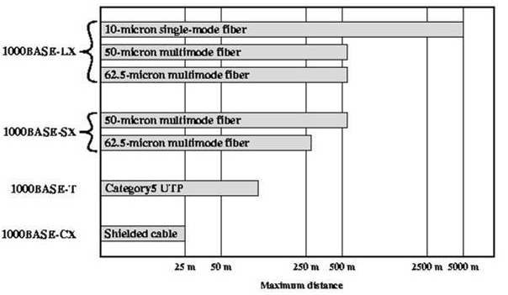
Gigabit Ethernet Media Options

Slide 26
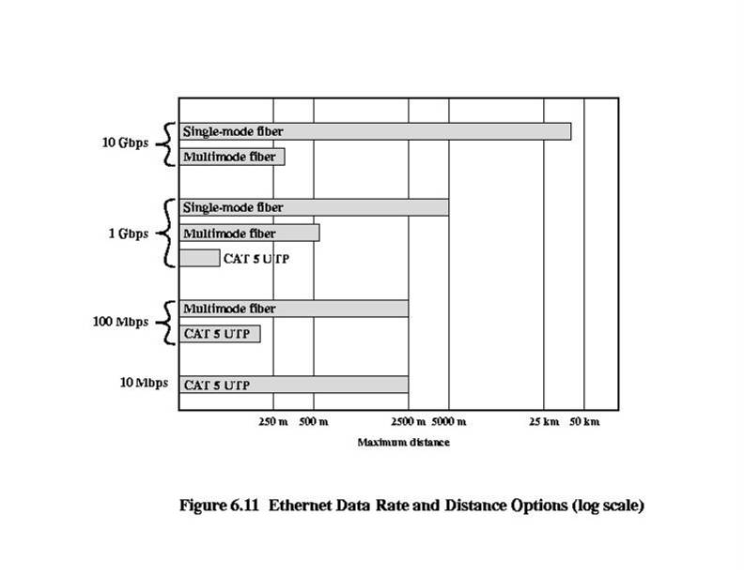
Ethernet Data Rate - Distance

Slide 27
Benefits of 10 Gbps Ethernet over ATM
No expensive, bandwidth consuming conversion between Ethernet packets and ATM cells
Network is Ethernet, end-to-end
IP plus Ethernet offers QoS and traffic policing capabilities approaching that of ATM
Wide variety of standard optical interfaces for 10 Gbps Ethernet

Slide 28
Fibre Channel
In data communications, there are 2 common methods to deliver data to the processor:
  via and I/O channel
  via the Network
Fibre channel combines best of both to provide
  the simplicity and speed of I/O channel communications
  the flexibility and interconnectivity of network communications
Not a shared-medium like 802.3
  switching fabric is point-to-point/multipoint
  no medium access issues

Slide 29
I/O Channel-Oriented Facilities
I/O Channel Characteristics:
  Primarily hardware based, designed for high speed over a short distance
  Minimal control… delivery and error detection
  Direct point-to-point or multipoint communications link
Fibre Channel Architecture defines:
  Data type qualifiers for routing payload
  Link-level constructs for individual I/O operations
  Protocol interface specifications to support existing I/O architectures, e.g. SCSI

Slide 30
Network-Oriented Fibre Channel Facilities
Network Characteristics:
  Manage transfers between end-systems
  Offer higher-level data communication services and control features
Fibre Channel Architecture defines
  Full multiplexing between multiple destinations
  Peer-to-peer connectivity between any pair of ports
  Internetworking with other connection technologies, e.g IEEE 802, ATM, IP

Slide 31
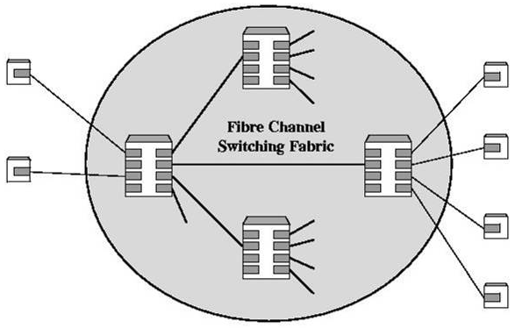
Switched Fibre Channel Network
N_Ports
Also:
L_Ports &
G_Ports
F_Ports
E_Ports

Slide 32
Fibre Channel Requirements (per the FCA)
Full duplex links with 2 fibers/link
100 Mbps – 800 Mbps (200-800 Mbps at full-duplex)
Distances up to 10 km
Small connectors
High-capacity, with distance insensitivity
Greater connectivity than existing multidrop channels
Broad availability (standard components)
Support for multiple cost/performance levels (PCs to super-computers)
Support for multiple existing interface command sets

Slide 33
Fibre Channel Protocol Architecture
Mapping
Common Services
Framing
Transmission
Physical
FC-4 Mapping: mappings to IEEE 802, ATM, IP, SCSI, etc.
FC-3 Common Services: multicasting (multiple ports on one node), etc.
FC-2 Framing Protocol: framing, grouping, flow and error control
FC-1 Transmission Protocol: signal encoding/decoding scheme
FC-0 Physical Media: signaling for optical fiber, coax, STP

Slide 34
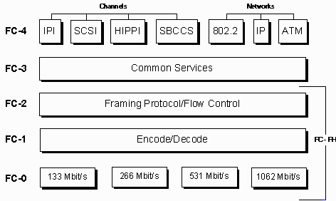
Fibre Channel Protocol Architecture

Slide 35
Fibre Channel Topologies
Point-to-point
  no intervening fabric switches
  no routing
Arbitrated loop
  conceptually similar to token ring
  up to 126 nodes
  SCSI
Fabric, or switched
  switched connection
  simple for nodes to manage
  IP

Slide 36
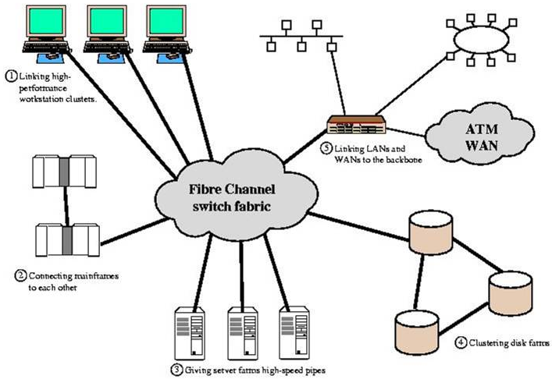
Fibre Channel Application Example
133 Mbps – 1 Gbps
Fiber, video coax,
STP
33 m – 10 km
point-to-point

Slide 37
Wireless LANs - Motivation
Replacement for traditional premise- based wired LANs
  ease of workstation relocation, addition
  cost of upgrading premise wiring
Site configuration demands
  large, open spaces (warehouses, stock exchange, manufacturing plants)
  historical buildings
LAN extension
  tying mobile devices into wired LAN infrastructure

Slide 38
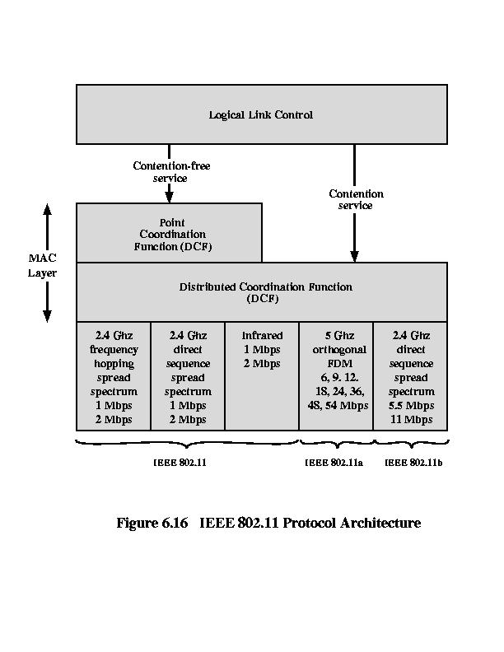
IEEE 802.11 Protocol Architecture
(PCF)
(DCF)
(1997)
(1999)

Slide 39
Wireless LAN Requirements
Throughput: maximize use of medium
Number of nodes: hundreds, across multiple APs
Connection to backbone: infrastructure and ad hoc permitted
Service area: diameter of up to 300m
Battery power consumption: devices must minimize power consumption, allow long battery life
Transmission robustness and security: reliable in noisy environments, secure from eavesdropping
Collocated network operation: allow multiple distinct wireless LANs in the same area
License-free operation: use “unlicensed” band
Hand-off/roaming: move between APs
Dynamic configuration: addition, deletion, relocation and reconfiguration of stations without disruption

Slide 40
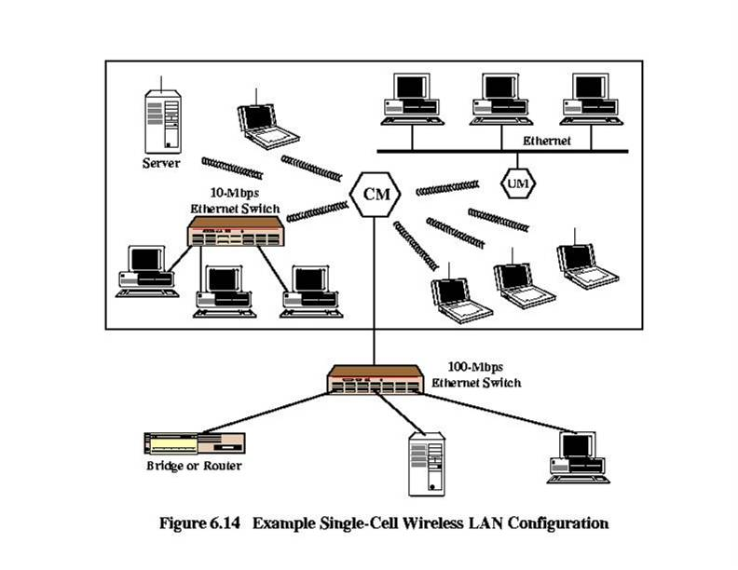
Single-Cell Wireless LAN -Example
CM = Control Module (access point)
UM = User Module (wireless hub)

Slide 41
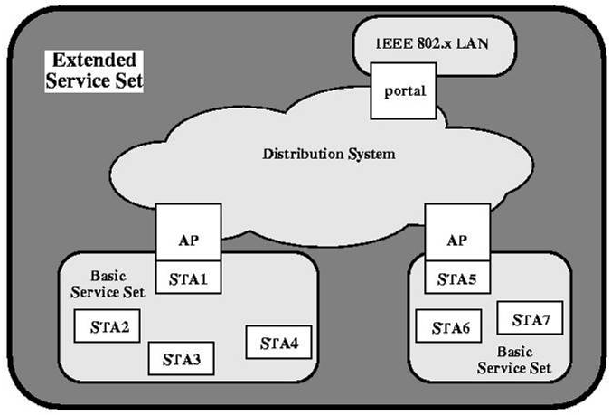
IEEE 802.11 Architecture
ESS (Extended Service Set) - appears to LLC as a single logical LAN
BSS (Basic Service Set)
BSS (Basic Service Set)

Slide 42
IEEE 802.11 Services
Association: establish and publish initial association between an AP and station
Reassociation: reestablish an existing association with another AP
Disassociation: terminate an existing association
Authentication: authenticate and establish identity between communicating stations
Privacy: encoding and encryption services

Slide 43
Performance Issues in Wireless Networks
Bandwidth limitation
High relative bit error rate (BER)
Higher latency
User mobility (handoff)
Effects on TCP congestion mechanisms and, therefore, performance and throughput?

Slide 44
Characteristics of High-Speed LANs
 | Fast Ethernet | Gigabit Ethernet | Fibre Channel | Wireless LAN
Data Rate | 100 Mbps | 1 Gbps, 10 Gbps | 100 Mbps – 3.2 Gbps | 1 Mbps – 54 Mbps
Transmission Mode | UTP,STP, Optical Fiber | UTP, shielded cable, optical fiber | Optical fiber, coaxial cable, STP | 2.4 GHz, 5 GHz Microwave
Access Method | CSMA/CD | CSMA/CD | Switched | CSMA/CA Polling
Supporting Standard | IEEE 802.3 | IEEE 802.3 | Fibre Channel Association | IEEE 802.11

